Slide 1
Welcome to the world of Cambrian Multimedia presentation.

Slide 2
Introduction
Md Hasan Hafizur Rahman
Senior Lecturer
Department of English
Cambrian School & College,Dhaka,
Class-Eight
English 1st Paper

Slide 3
Do you have any idea about a dialogue?
Let us see.

Slide 4
Our Today’s Lesson is-
A dialogue on
“Plan after the Exam”

Slide 5
Learning outcomes
After we have studied this lesson we will be able to-
exchange greetings
ask and answer questions
achieve inspiration
write a dialogue.

Slide 6
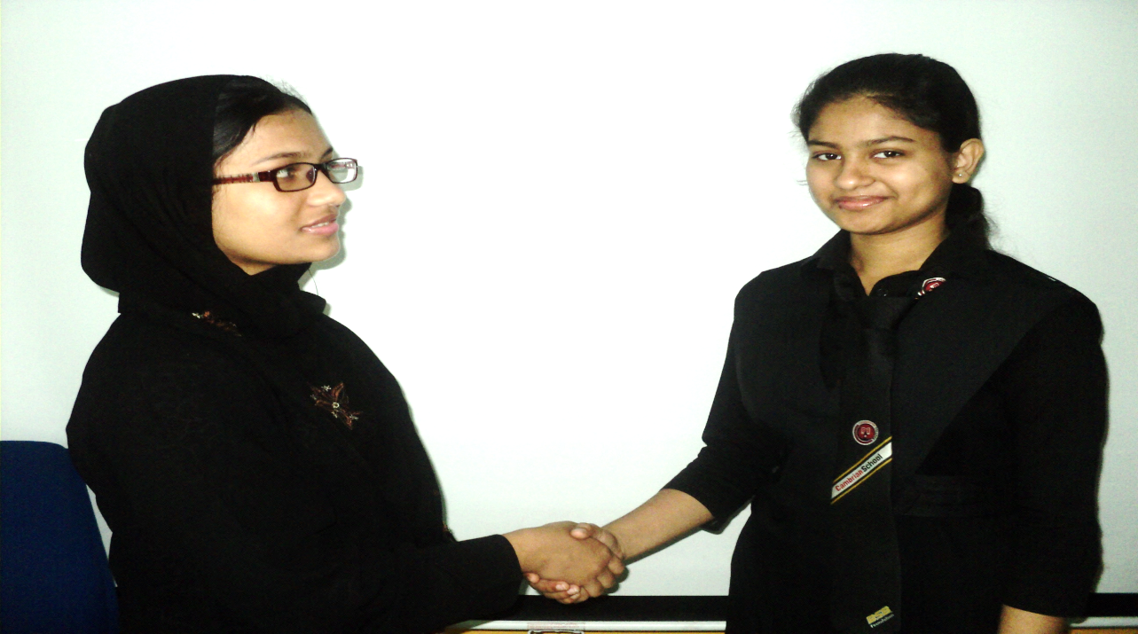
Assalamu Alaikum
Walaikum Assalam

Slide 7
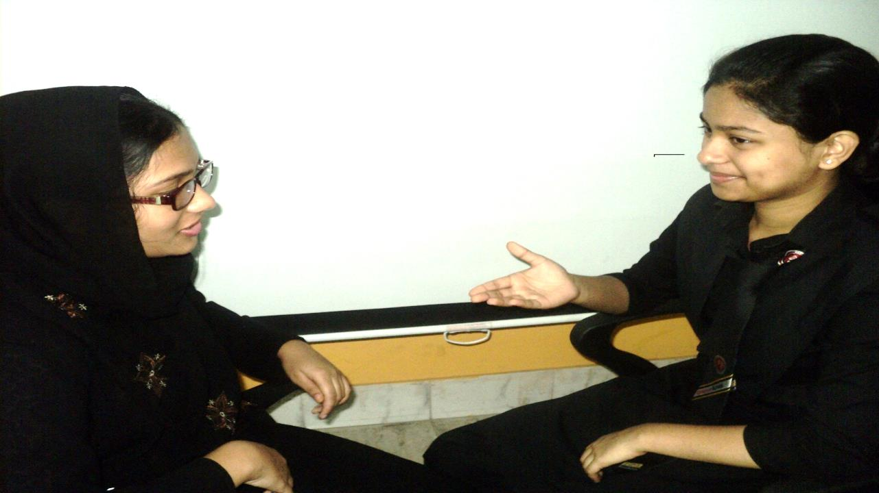
How are you my friend?
Alhamdulillah. What about you?

Slide 8
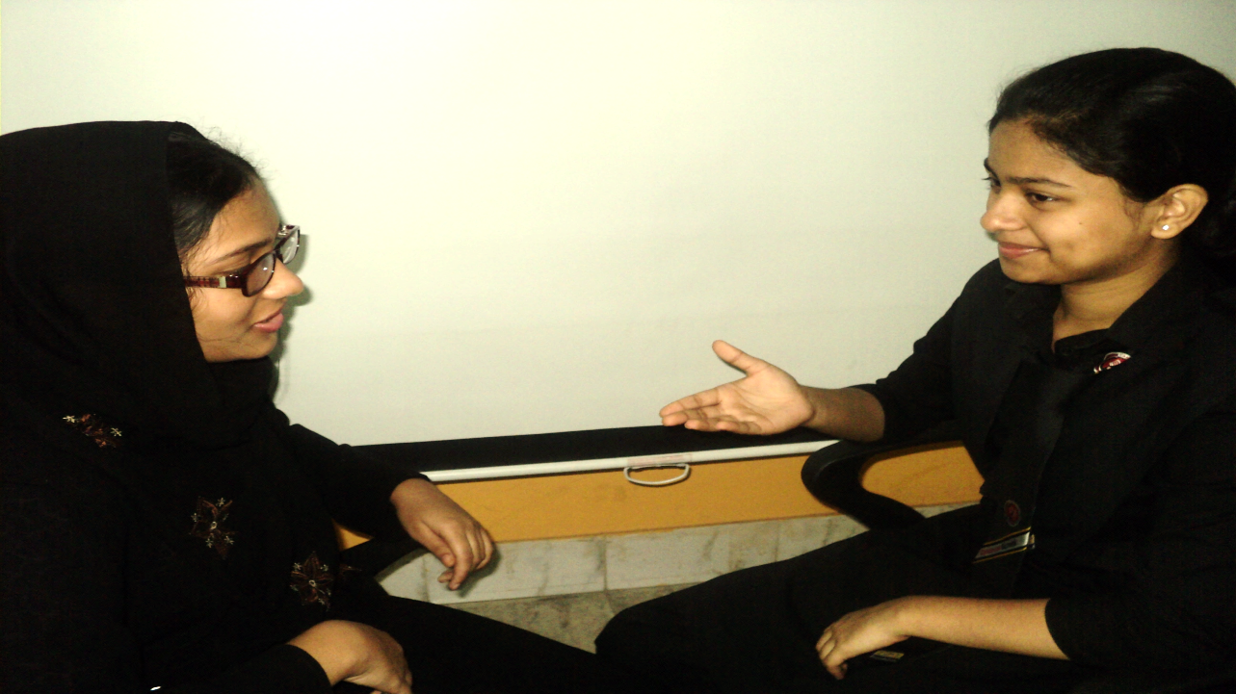
Well. How are you going on the exam?
Alhamdulillah, very well and you?

Slide 9
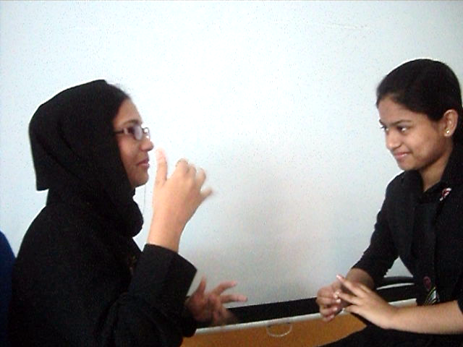
Very well by Allah’s grace.
Now what are you planning after the JSC exam?

Slide 10
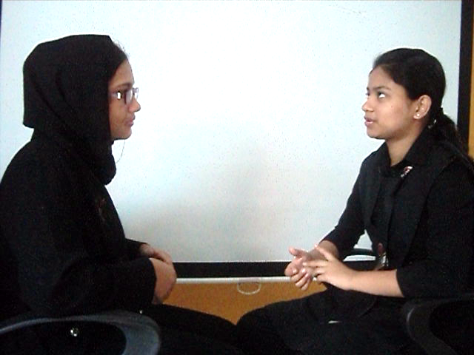
I am planning to pass this time having a tour inside the country.
Ok, it’s a very good idea. But why have you planned so?

Slide 11
It was a long cherished dream to me. Now tell me what is your plan?
But my plan is not same like you.

Slide 12
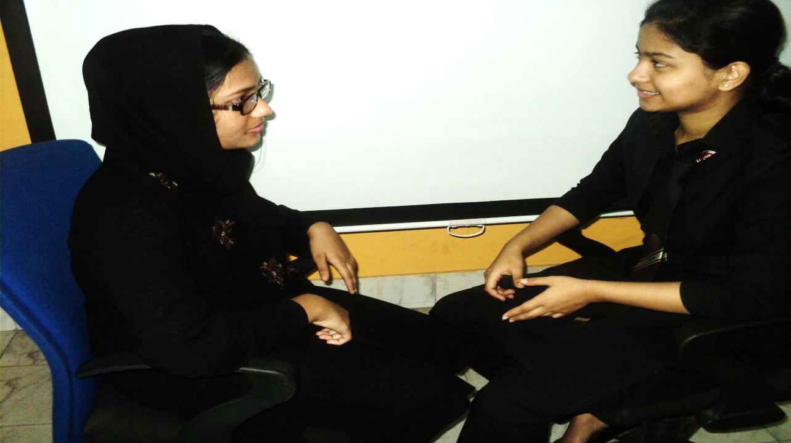
What is that actually?
It is about learning English.

Slide 13
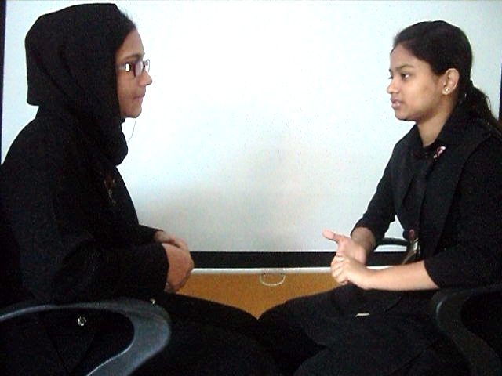
What do you mean?
I mean, I will learn spoken English as I am somewhat weak in English.

Slide 14
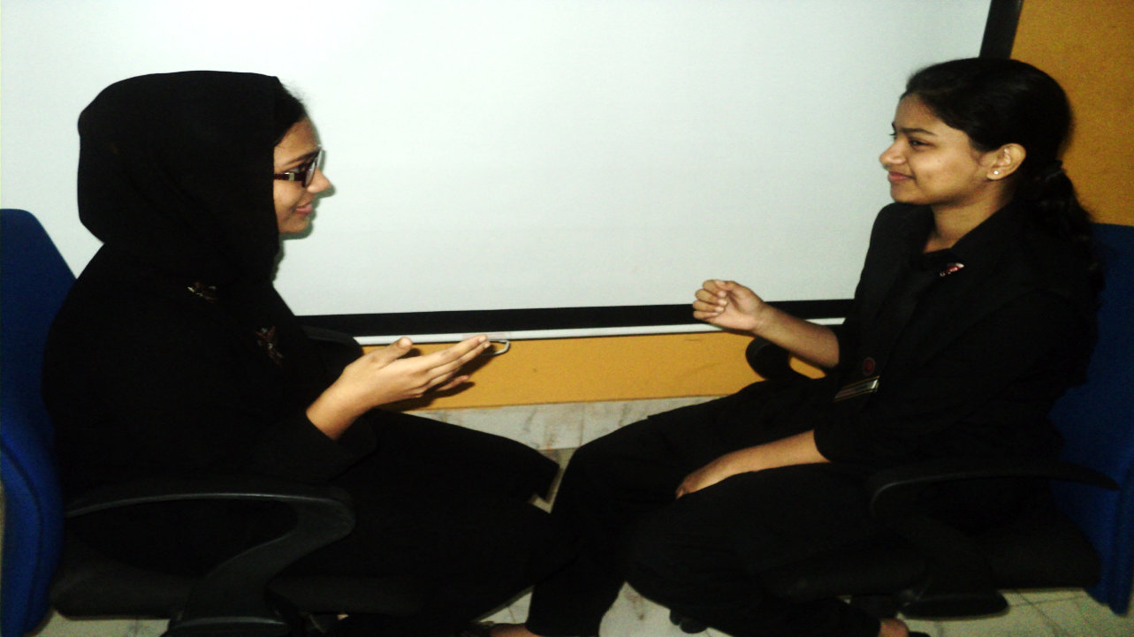
It’s a very excellent idea.
Ok. What places will you visit first?

Slide 15
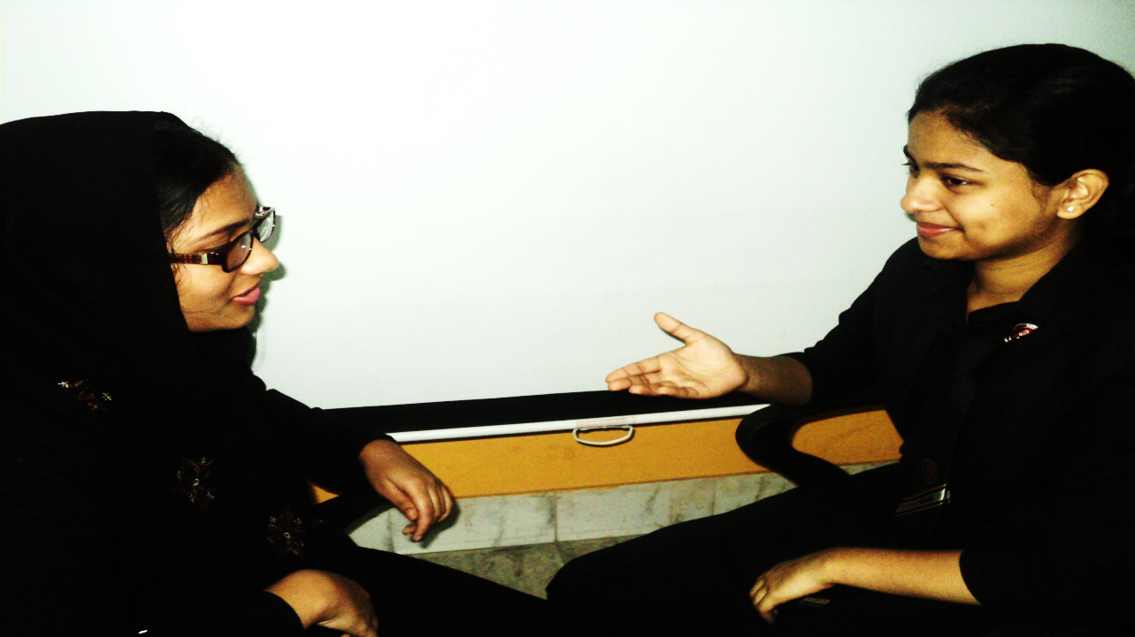
I think I will start from Bagerhat. First Shat Gumbuj Mosque, Khanjahan Ali’s majar and then Sundarban.
Ok. I hope you all the success.

Slide 16
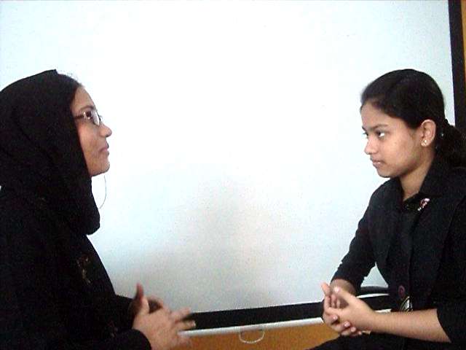
Wish you best of luck.
Also you.

Slide 17
Pair Work
Every single pair is suggested
to write a dialogue on,
“ Plan after the JSC exam.”

Slide 18
Evaluation
Answer the following questions-
What is the dialogue about?
What have you planned after the JSC Exam?
Where do you like to go after the exam?
How will you be benefited with the tour?

Slide 19
Homework
Make a dialogue with your friend about
“Plan after the JSC exam”

Slide 20
Verse Universal
“Speak less, work more”

Slide 21
Bye bye
Good bye

